Slide 1





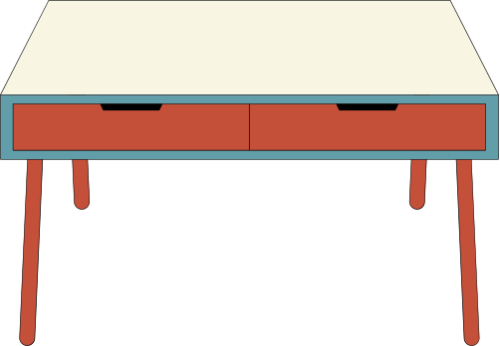

Department of AI & ML, SIT, Pune
1
PDS AIML- B2
MULTIPLE DISEASE PREDICTION (PARKINSON'S , DIABETES AND HEART DISEASES) WITH FRONTEND DEPLOYMENT
MULTIPLE DISEASE PREDICTION (PARKINSON'S , DIABETES AND HEART DISEASES) WITH FRONTEND DEPLOYMENT
SNEH PATEL - 22070126113
SHUBH AGRAWAL - 22070126108
SHREYASEE SHINDE - 22070126106

Slide 2
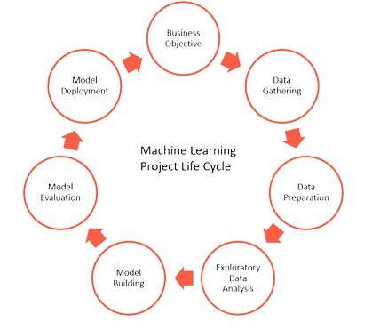

Department of AI & ML, SIT, Pune
2
MACHINE LEARNING LIFE CYCLE
MACHINE LEARNING LIFE CYCLE

Slide 3

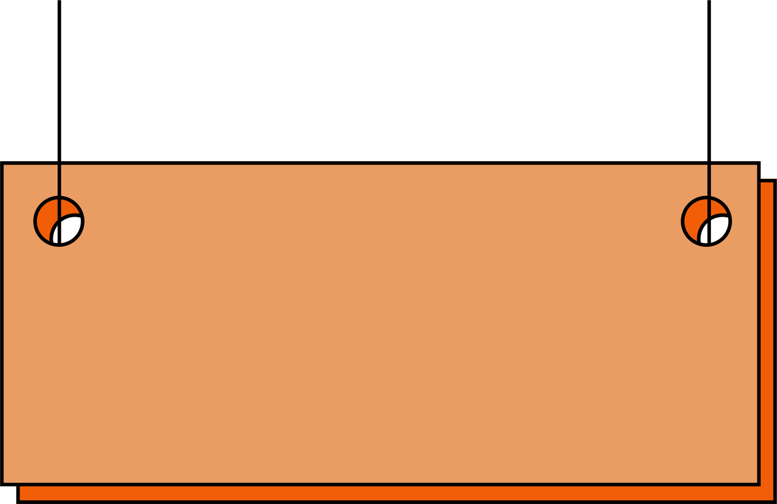


Department of AI & ML, SIT, Pune
3
1)BUSINESS OBJECTIVES
1)BUSINESS OBJECTIVES
INCOME SOURCE : Google AdSense
Creating a web application for predicting multiple diseases (Parkinson's, diabetes, and heart diseases) and incorporating Google AdSense for monetization including building the backend, frontend, integrating machine learning models, and adding Google AdSense advertisements.
Increased Consultation Demand
Customized Wellness Plans

Slide 4



Department of AI & ML, SIT, Pune
2) DATA GATHERING
4
2) DATA GATHERING
1) DIABETES DISEASE PREDICTION: https://www.kaggle.com/datasets/saurabh00007/diabetescsv
2) PARKINSON’s DISEASE PREDICTION: https://www.kaggle.com/datasets/debasisdotcom/parkinson-disease-detection
3) HEART DISEASE PREDICTION: https://archive.ics.uci.edu/dataset/45/heart+disease
MACHINE LEARNING MODEL OF EACH DISEASE WLL BE CREATED USING THESE DATASETS AND WILL BE COMINBED TO FORM A FINAL WEBSITE FOR MULTIPLE DISEASE PREDICTION.

Slide 5


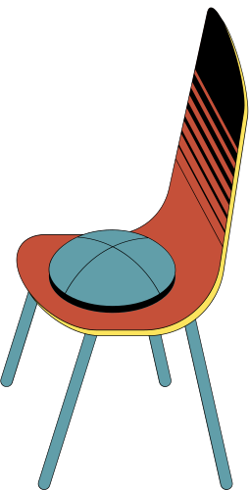
Department of AI & ML, SIT, Pune
5
DATA PREPARATION
DATA PREPARATION
Firstly we checked for NULL values in our 3 datasets using some common function such as isnull() and .sum() , there were no null values found in our datasets , Thus we performed some DPL tasks such as .describe() , .head() , .tail() , .info() to get some particular information like attributes , statistical measures ( mean , median , quartiles and standard deviation) .

Slide 6
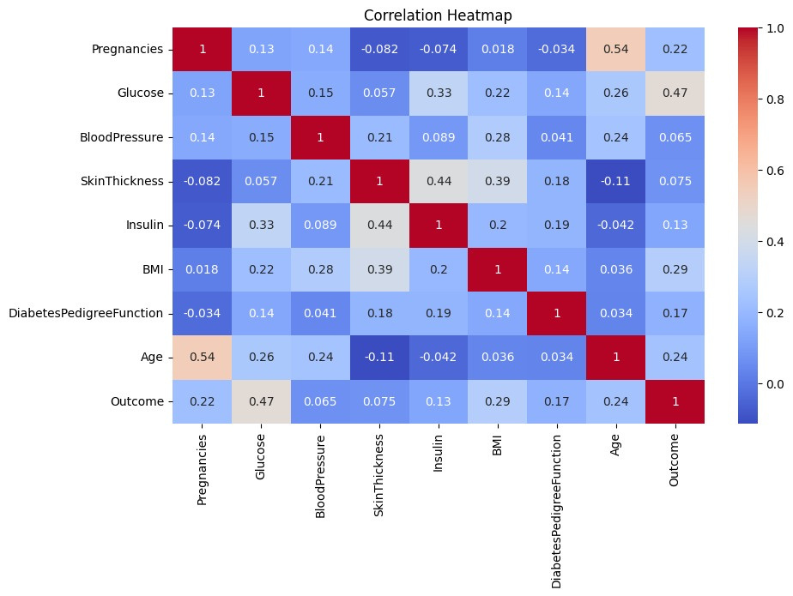
Department of AI & ML, SIT, Pune
EDA GRAPHS OF DATASET ( DIABETES )
6
EDA GRAPHS OF DATASET ( DIABETES )

Slide 7
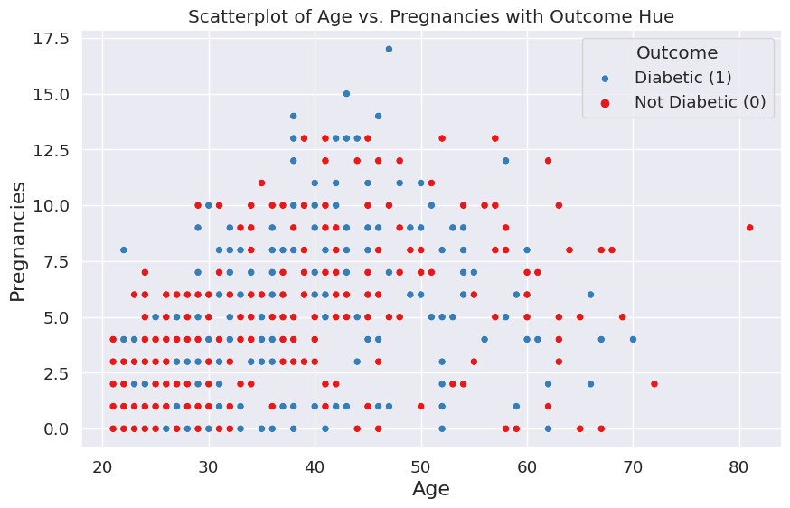
EDA GRAPHS OF DATASET ( DIABETES )
Department of AI & ML, SIT, Pune
EDA GRAPHS OF DATASET ( DIABETES )
7

Slide 8
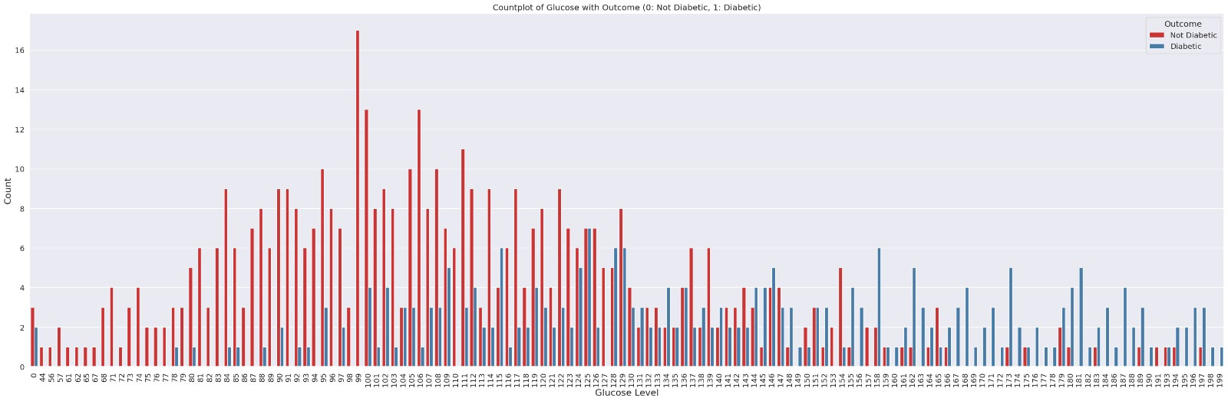
Department of AI & ML, SIT, Pune
EDA GRAPHS OF DATASET ( DIABETES )
8
EDA GRAPHS OF DATASET ( DIABETES )

Slide 9
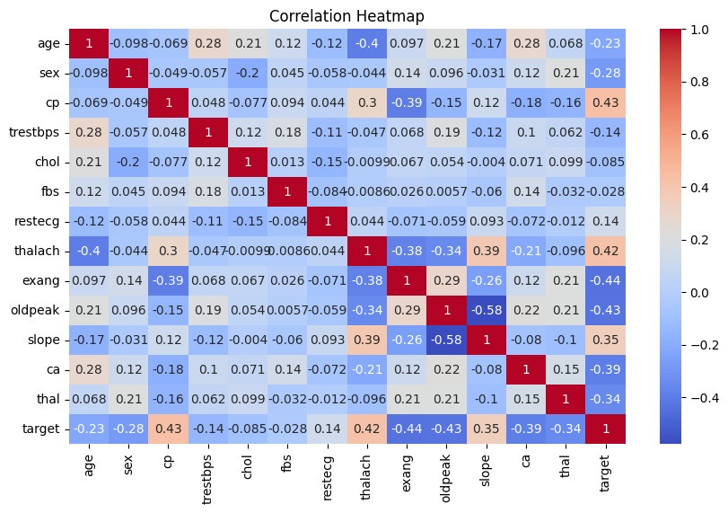
Department of AI & ML, SIT, Pune
EDA GRAPHS OF DATASET ( HEART )
9
EDA GRAPHS OF DATASET ( HEART )

Slide 10
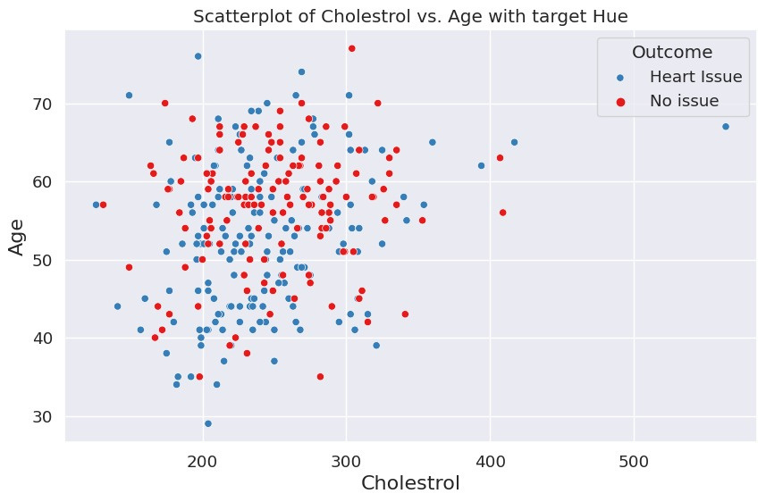
Department of AI & ML, SIT, Pune
EDA GRAPHS OF DATASET ( HEART )
10
EDA GRAPHS OF DATASET ( HEART )

Slide 11
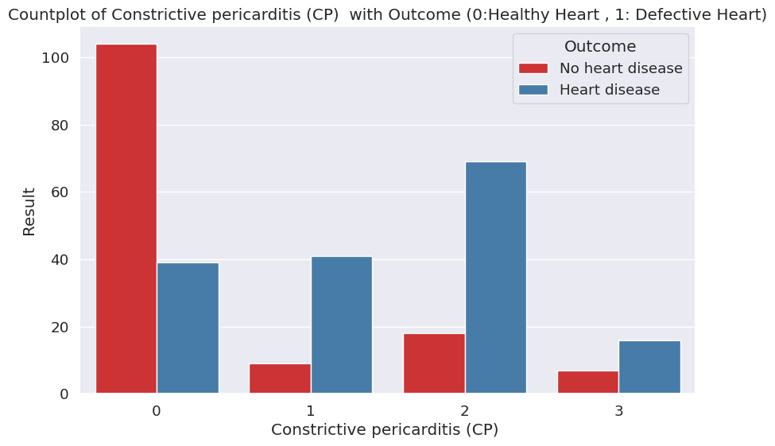
Department of AI & ML, SIT, Pune
EDA GRAPHS OF DATASET ( HEART )
11
EDA GRAPHS OF DATASET ( HEART )

Slide 12
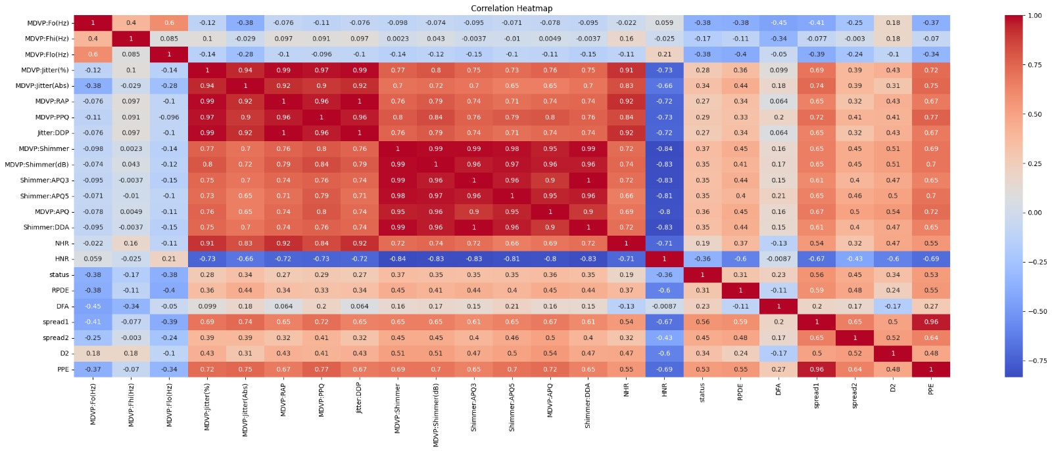
EDA GRAPHS OF DATASET ( PARKINSON )
Department of AI & ML, SIT, Pune
EDA GRAPHS OF DATASET ( PARKINSON )
12

Slide 13
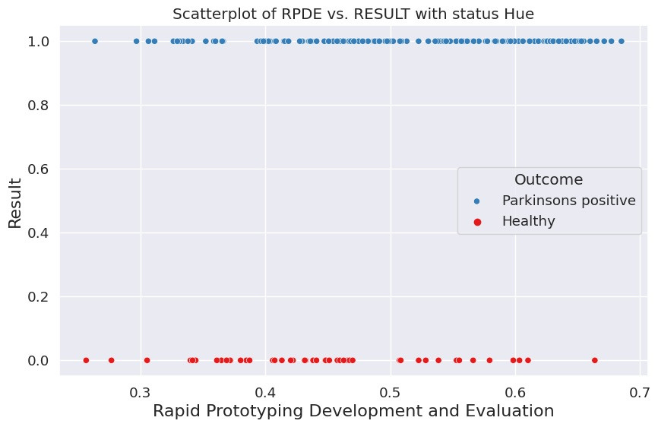
EDA GRAPHS OF DATASET ( PARKINSON )
Department of AI & ML, SIT, Pune
EDA GRAPHS OF DATASET ( PARKINSON )
13

Slide 14
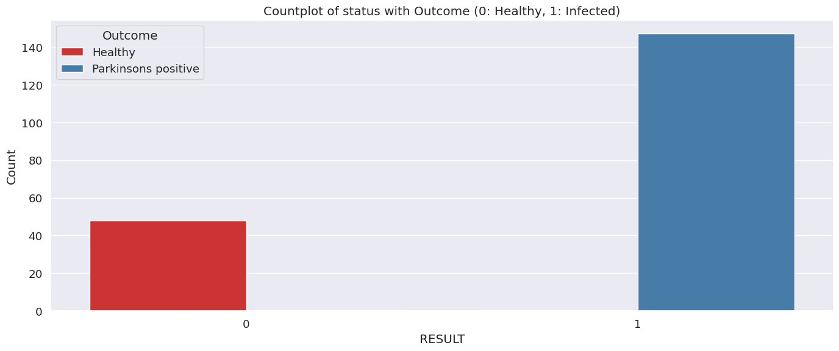
EDA GRAPHS OF DATASET ( PARKINSON )
Department of AI & ML, SIT, Pune
EDA GRAPHS OF DATASET ( PARKINSON )
14

Slide 15



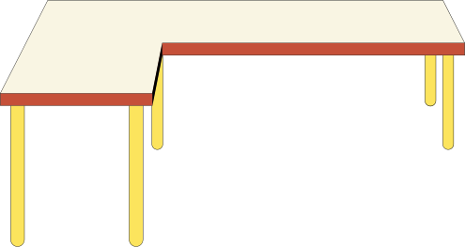
MODEL BUILDING
MODEL BUILDING
Department of AI & ML, SIT, Pune
15
HEART DISEASE
PREDICTION
DIABETES DISEASE
PREDICTION
HEART DISEASE
PREDICTION
PARKINSON DISEASE
PREDICTION
DIABETES DISEASE
PREDICTION
PARKINSON DISEASE
PREDICTION
Splitting the Data into Training data & Test Data (80:20).
Naive Bayes classifier is used.
Naive Bayes is preferred for diabetes prediction for its simplicity, efficiency, probabilistic outputs, and suitability for mixed data.
Splitting the Data into Training data & Test data (80:20).
LogisticRegression is used.
LogisticRegression suits heart disease prediction due to its ability to model binary outcomes, interpretability, and minimal overfitting risk.
Splitting the Data into Training data & Test data (80:20).
SVM classifier is used.
SVM is suitable for Parkinson's disease prediction due to its capacity to find complex decision boundaries and handle non-linear relationships in data.

Slide 16


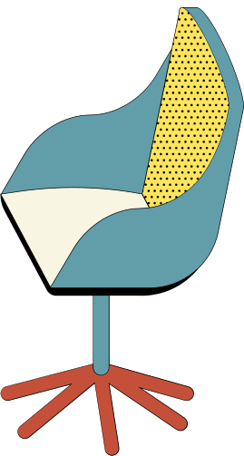
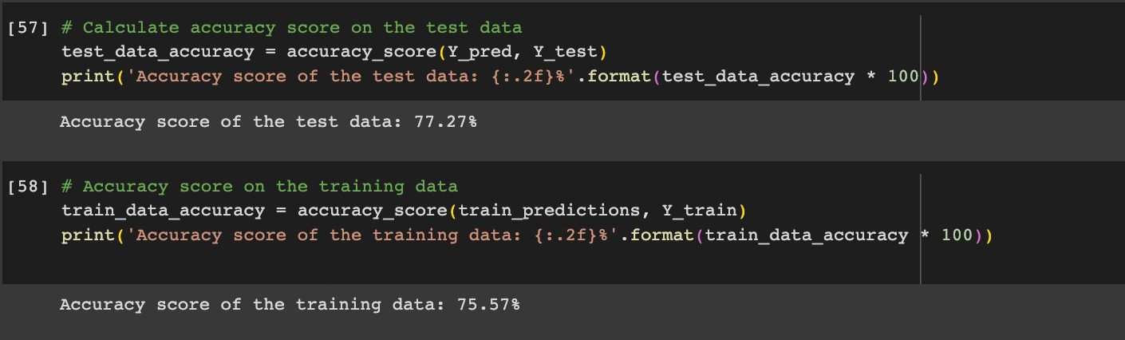
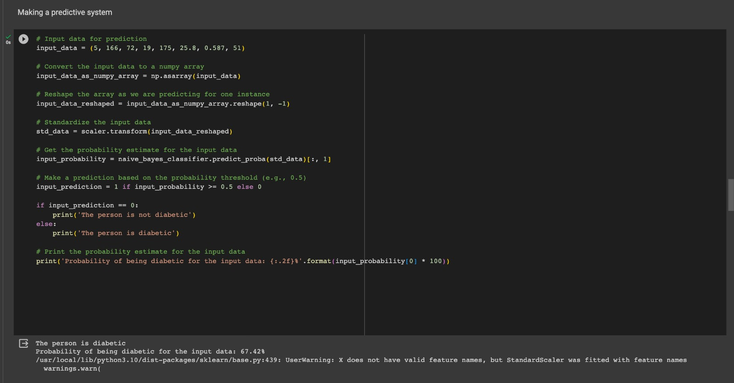
Department of AI & ML, SIT, Pune
16
MODEL EVALUTAION
MODEL EVALUTAION
This is the accuracy score of the trained diabetes model.
This is the prediction obtained by feeding input in our trained diabetes model.

Slide 17

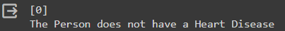
Department of AI & ML, SIT, Pune
17
MODEL EVALUTAION
MODEL EVALUTAION
This is the accuracy score of the trained heart model.
This is the prediction obtained by feeding input in our trained heart model.

Slide 18

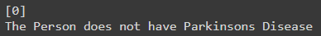
Department of AI & ML, SIT, Pune
18
MODEL EVALUTAION
MODEL EVALUTAION
This is the accuracy score of the trained Parkinson model.
This is the prediction obtained by feeding input in our trained Parkinson model.

Slide 19
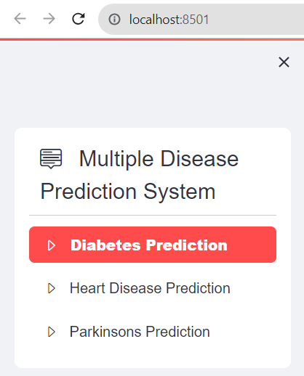
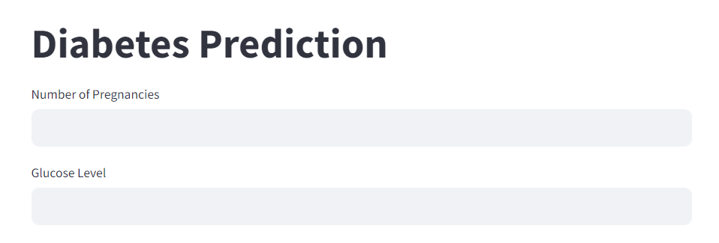
Department of AI & ML, SIT, Pune
19
MODEL DEPLOYMENT
MODEL DEPLOYMENT
Model Deployment was done using Streamlit which is an open-source Python library for building web applications with simple code, primarily used for data visualization.
In this deployment we have used libraries such as :
Pickle:- It has been used for loading models of three diseases in spyder .
streamlit:- This package has been used for frontend deployment whih directly links to the localhost .
streamlit options menu:- This package has been used for navigating to a particular disease to be predicted .

Slide 20


Department of AI & ML, SIT, Pune
REFRENCES:
20
REFRENCES:
[1] For frontend and to gain knowledge for the deployment using streamlit we refered to a particular video. https://www.youtube.com/watch?v=8Q_QQVQ1HZA&list=PLfFghEzKVmjvuSA67LszN1dZ-Dd_pkus6&index=26
[2] Litjens, G., Kooi, T., Bejnordi, B. E., Setio, A. A. A., Ciompi, F., Ghafoorian, M., ... & Sánchez, C. I. (2017). A survey on deep learning in medical image analysis. Medical image analysis, 42, 60-88. https://www.sciencedirect.com/science/article/pii/S1361841517301127
[3] Goodfellow, I., Bengio, Y., & Courville, A. (2016). Deep Learning. MIT Press. https://www.deeplearningbook.org/
[4] Chen, L. C., Zhu, Y., Papandreou, G., Schroff, F., & Adam, H. (2018). Encoder-decoder with atrous separable convolution for semantic image segmentation. In Proceedings of the European conference on computer vision (ECCV). https://openaccess.thecvf.com/content_ECCV_2018/html/Liang-Chieh_Chen_EncoderDecoder_with_Atrous_ECCV_2018_paper.html

Slide 21
Department of AI & ML, SIT, Pune
21
THANK YOU!
THANK YOU!

